Slide 1


Common-Mode fundamentals for
Shipboard Power Systems
Part 4
Common Mode Modeling
Cables and CM chokes
Dr. Norbert Doerry
Dr. John Amy
http://doerry.org/norbert/MarineElectricalPowerSystems/index.htm
© 2025 by Norbert Doerry and John Amy
This work is licensed via: CC BY 4.0 (https://creativecommons.org/)

Slide 2
Common Mode Lumped Parameter circuit model
Goal is to create a simplified circuit model that only models the impact of CM currents.
  Gain an understanding of where CM currents will flow.
  Gain an understanding of the magnitude of CM currents and voltage.
  Gain an understanding of what mitigation methods are likely to be successful or not.
Modeling devices with mutual inductance poses special challenges

Slide 3
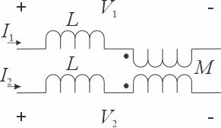
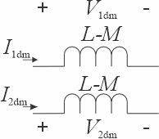

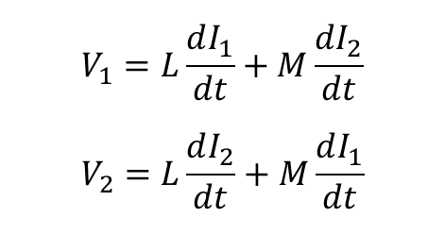
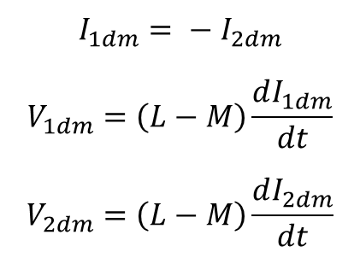
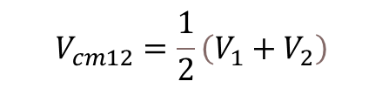
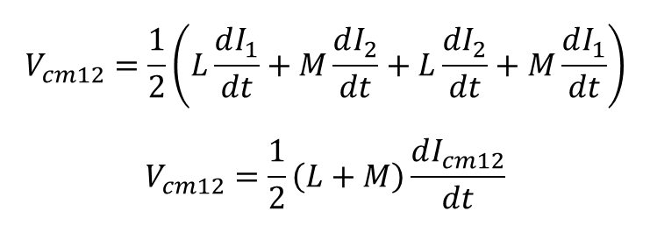
Models for Mutual Inductance
$$V_{1}=L\frac{dI_{1}}{dt}+M\frac{dI_{2}}{dt}$$
$$V_{2}=L\frac{dI_{2}}{dt}+M\frac{dI_{1}}{dt}$$
Common Mode Model
$$V_{cm12}=\frac{1}{2}\left(V_{1}+V_{2}\right)$$
$$V_{cm12}=\frac{1}{2}\left(L\frac{dI_{1}}{dt}+M\frac{dI_{2}}{dt}+L\frac{dI_{2}}{dt}+M\frac{dI_{1}}{dt}\right)$$
$$V_{cm12}=\frac{1}{2}\left(L+M\right)\frac{dI_{cm12}}{dt}$$
Differential Mode Model
$$I_{1dm}= − I_{2dm}$$
$$V_{1dm}=\left(L−M\right)\frac{dI_{1dm}}{dt}$$
$$V_{2dm}=\left(L−M\right)\frac{dI_{2dm}}{dt}$$
The inductance value provided for cables is typically L – M which is appropriate for Differential Mode Models. It is not appropriate for CM models

Slide 4

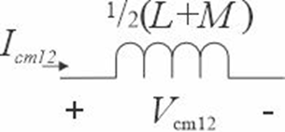
Common Mode Chokes
Common Mode Chokes are designed to maximize L and M as well as make L and M nearly equal.
  Maximize common mode impedance
  Minimize differential mode impedance.

Slide 5
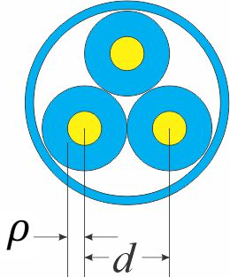
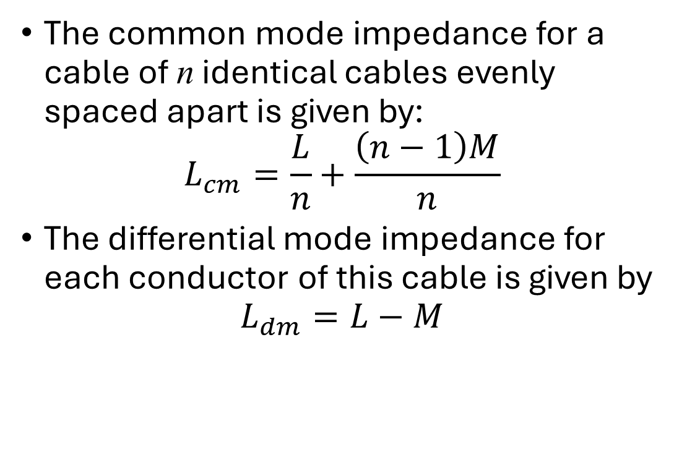
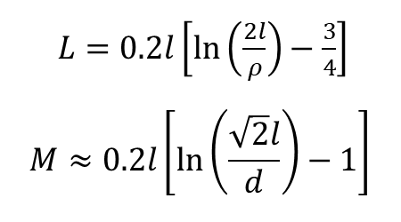
Calculating Cable inductances
(unarmored cable)
The common mode impedance for a cable of n identical cables evenly spaced apart is given by:
$$L_{cm}=\frac{L}{n}+\frac{\left(n−1\right)M}{n}$$
The differential mode impedance for each conductor of this cable is given by
$$L_{dm}=L−M$$
$L=0.2l\left[\text{ln}\left(\frac{2l}{ρ}\right)−\frac{3}{4}\right]$
$$M≈0.2l\left[\text{ln}\left(\frac{\sqrt{2}l}{d}\right)−1\right]$$
Where l is the cable length (m)
ρ and d in m
L and M in µH
For other configurations, see
Doerry, Norbert, Mohammed Islam, John Prousalidis, Design of Shipboard Power System Grounding / Earthing, IEEEPress – Wiley 2025
Grover, Frederick W., Inductance Calculations, Dover Publications, Inc., Mineola NY, 2009

Slide 6
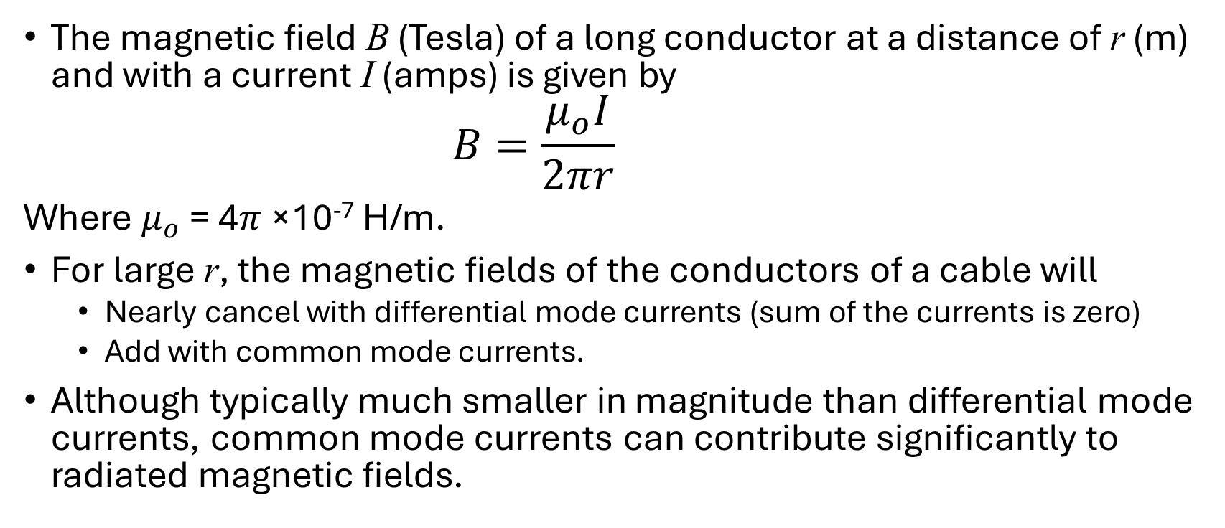
Impact of common mode current on radiated emissions (EMI) of cable
The magnetic field B (Tesla) of a long conductor at a distance of r (m) and with a current I (amps) is given by
      $$B=\frac{μ_{o}I}{2πr}$$
Where $μ_{o}$ = 4$π$ ×10⁻⁷ H/m.
For large r, the magnetic fields of the conductors of a cable will
  Nearly cancel with differential mode currents (sum of the currents is zero)
  Add with common mode currents.
Although typically much smaller in magnitude than differential mode currents, common mode currents can contribute significantly to radiated magnetic fields.

Slide 7
Wrap up

